Slide 1



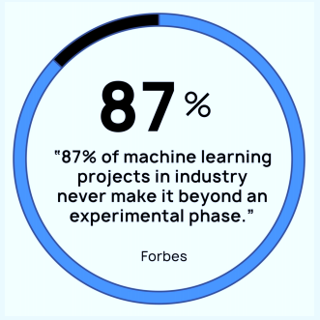
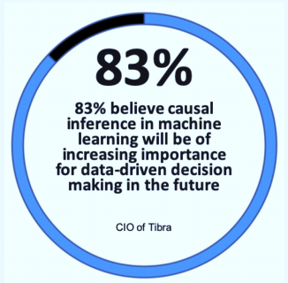
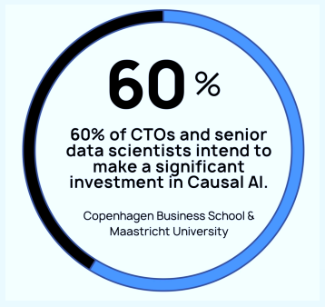
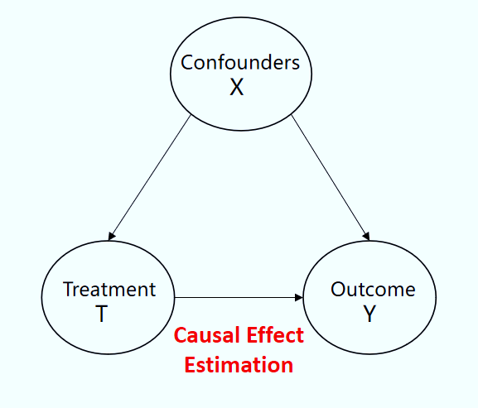
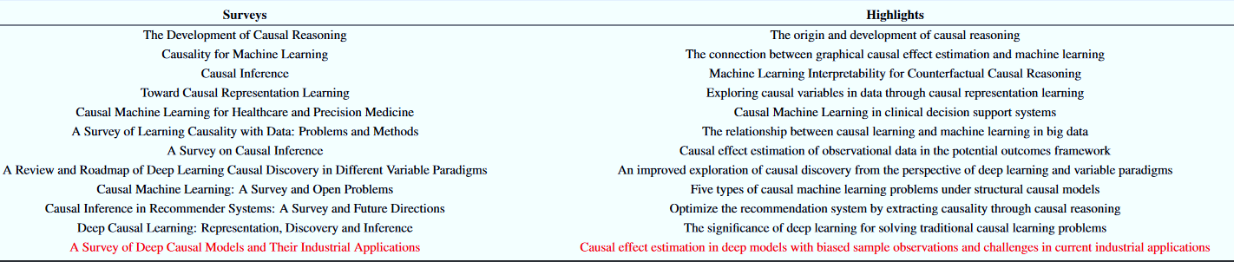
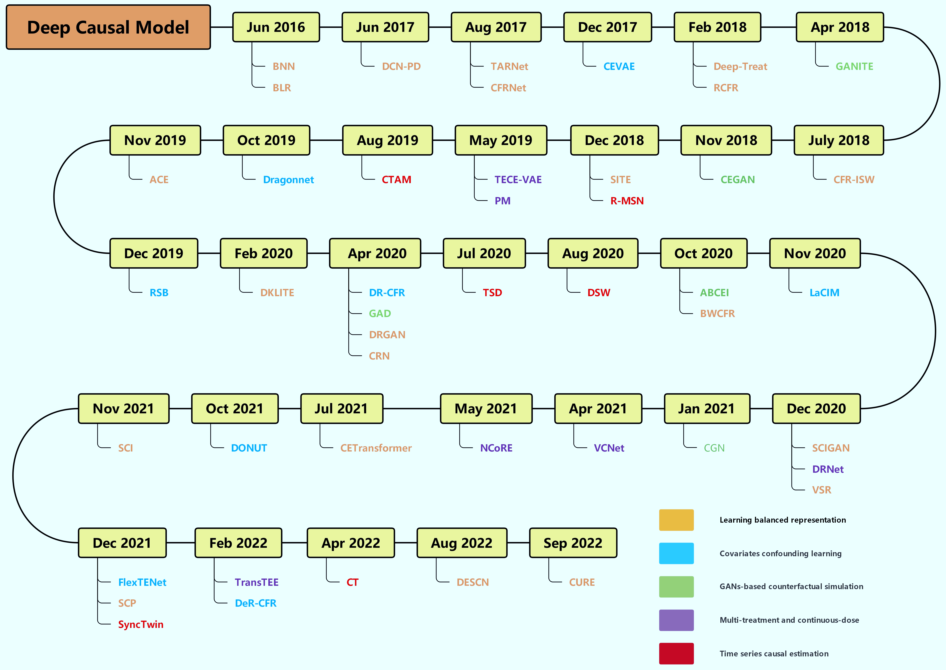
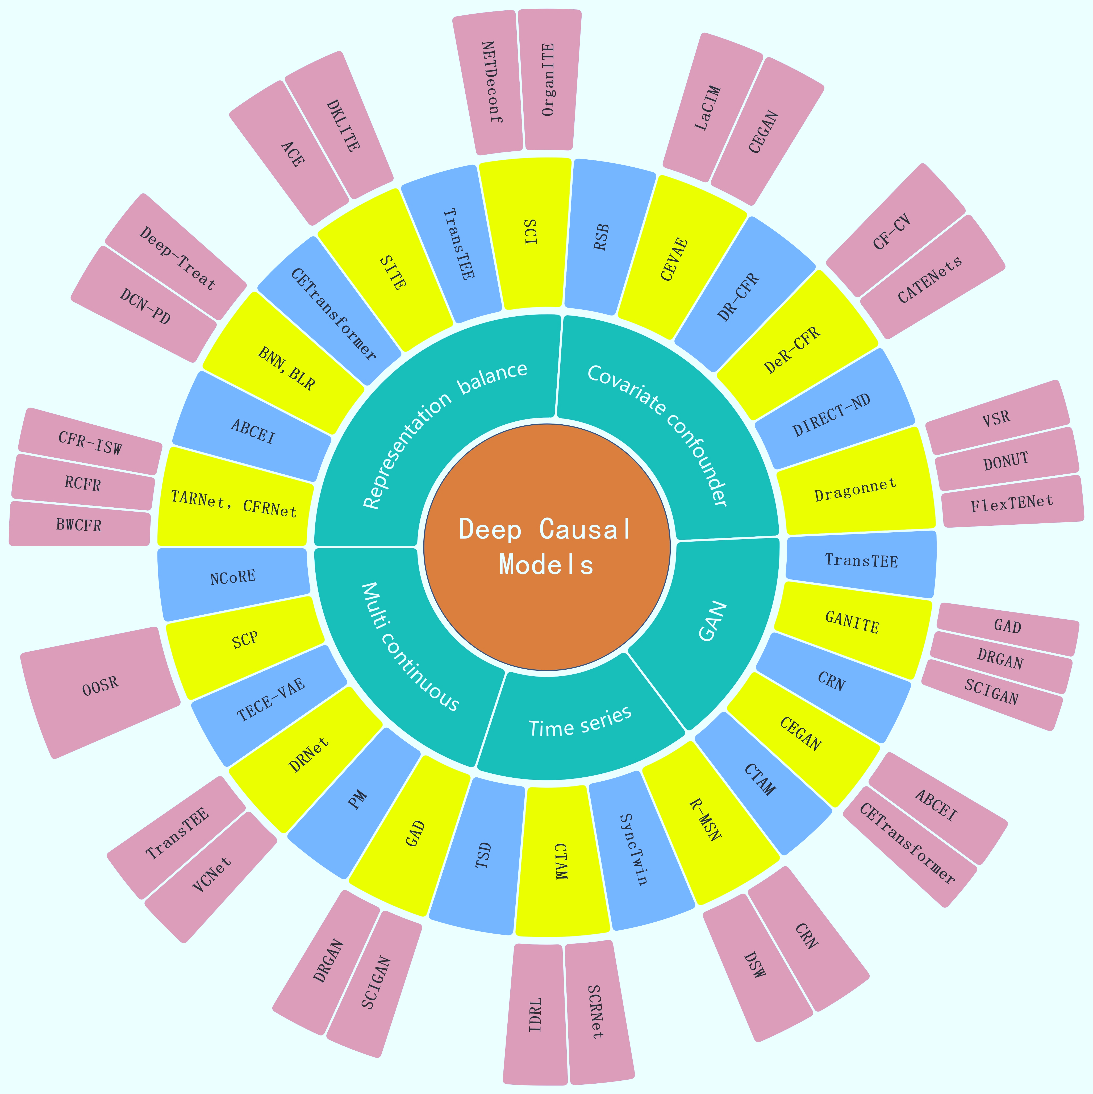
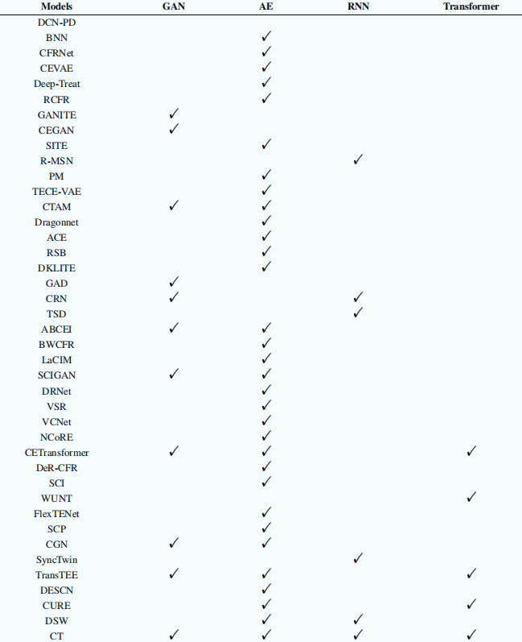
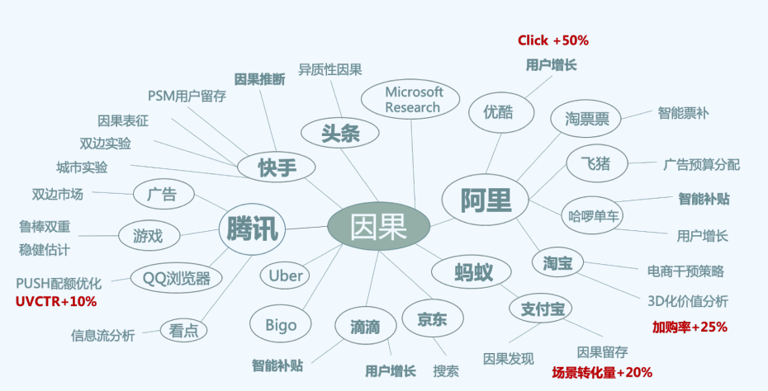
A Survey of Deep Causal Models and Their Industrial Applications
Zongyu Li^{1,2}, Zhenfeng Zhu^{1,2}, Xiaobo Guo³, Siwei Qiang³ and Yao Zhao^{1,2}
1.School of Computer and Information Technolog, Beijing Jiaotong University, China
2. Institute of Information Science, Beijing Jiaotong University, China
2. MYBank, Ant Group, China
Problems: How to provide a overview of the latest applications of deep causal models in industry
Introduction
Preliminaries
Challenges: Representation learning, Debias estimation, Counterfactual inference
Definitions: Observed outcome, Counterfactual outcome, Dose, Covariates
Assumptions: Stable Sample Treatment Value , Ignorability, Overlap
Treatments: Binary treatment, Multiple treatment, Continuous dose treatment
Metrics: ATE、ITE、ATT、CATE、PEHE、RMSE、MISE、DPE、PE
Datasets: IHDP、Jobs、Twins、News、ACIC、TCGA、MIMIC III
Materials and Methods: Development of Deep Causal Models
A Timeline of Development
Model Classification
1) Learning balanced representations;
2) Covariate confounding learning;
3) Time series causal learning;
4) GANs based Counterfactual simulation;
5) Multi treatment and continuous dose treatment.
We present the development timeline about 50 classical deep causal models from June 2016 to November 2022.
Summary: Typical Deep Causal Models and Their Industrial Applications
Deep Frameworks on Classical Causal Models
Current Status of Industrial Applications
Future Prospect
It is inseparable from the proposal of deep network models such as statistical theory, biological application scenarios and the reliable assumptions of Robin causal model.
 | Application Scenario | Problem
Marketing | Maximizing the return on investment | Estimate users’ purchase probability with different incentives
E-commerce | Recommender systems with causality | Address selection bias, exposure bias, position bias and conformity bias in recommender systems
Financial | Estimating the impact of policies | Solve the biased problem of non-A/B experiment to measure the intervention effect
Economic | Gaining transparent strategies | Learn causal effects from surrogate experiments with selection-biase and imperfect compliance
Medical | Precision medicine | Explore quantitative individual-level effect of a treatment with assignment bias
Educational | Determine best policies and practices | Effectiveness of an intervention is multifaceted and complex

